Slide 1
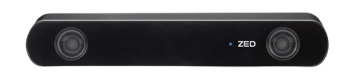
ZED 2i Stereo Camera
Description
The ZED2i is a rugged, high-precision stereo camera for outdoor environments and challenging conditions.
It provides depth perception and 3D mapping capabilities for applications like robotics, drones, and autonomous vehicles.
The camera excels in SLAM, visual odometry, and depth sensing tasks, offering highly accurate real-time 3D data.
Specifications
Operating Voltage - 5V
Detection Range - Up to 20m (3D) & Up to 40m (2D)
Field of View - 120º
IMU - 6DoF
Applications
Autonomous Robots
Drones and UAVs
AR/VR (Augmented and Virtual Reality
SLAM and 3D Mapping
Official Website : https://www.stereolabs.com/en-in/store/products/zed-2i

